Slide 1

Quizzify
AI-Powered Quiz Game
Built with Python, PyGame, and LLM integration - Shreyash Atre - Samira Vadake - Ayush Teli

Slide 2
The Problem
Repetitive Experience
No Adaptive Learning
Poor User Experience
Traditional quizzes rely on static question banks that quickly become predictable and boring for repeat users.
Existing quiz platforms fail to adjust difficulty based on user performance, leading to frustration or disengagement.
Most educational quiz applications lack intuitive UI/UX design, making learning feel like a chore rather than an engaging activity.

Slide 3

Project Objectives
01
02
Visual Polish
Dynamic Questions
Create a beautifully designed quiz game with smooth animations and professional-grade user interface elements.
Implement intelligent question loading with optional AI integration to generate fresh, contextual content on demand.
03
Seamless Flow
Deliver a frictionless user journey from start screen through quiz gameplay to final results presentation.

Slide 4
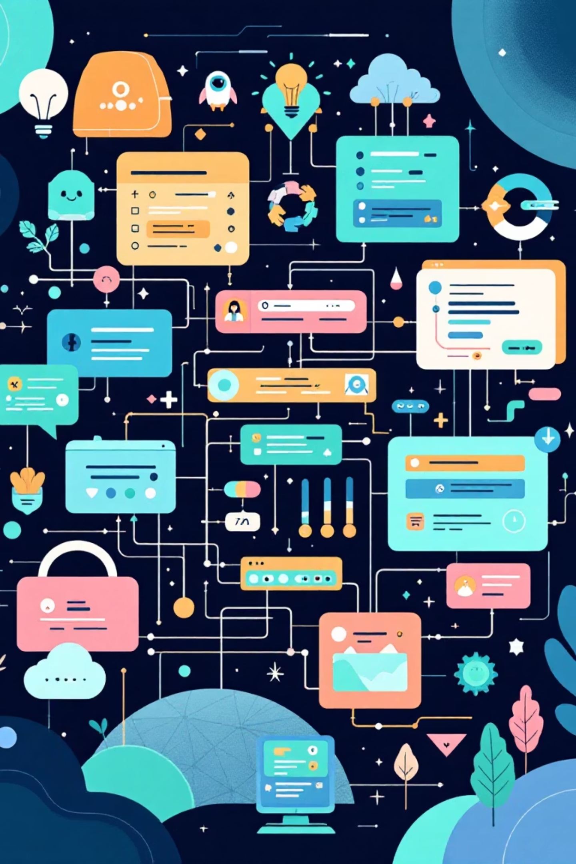
System Architecture
UI Layer
Game Logic
Question Engine
PyGame Screens
Core Engine
Content Module
Handles all visual rendering, transitions, and user interactions across multiple game states.
Manages scoring system, timer functionality, question progression, and state management.
Powers question delivery through LLM API integration for dynamic generation.

Slide 5





Core Features
Multi-Screen UI
Score Tracking
Start, Quiz, and Result screens with smooth transitions
Accurate calculation and display of user performance
Randomization
Animations
Dynamic question ordering for varied gameplay
Polished transitions and responsive visual feedback
AI Module
Optional LLM integration for generating fresh questions

Slide 6
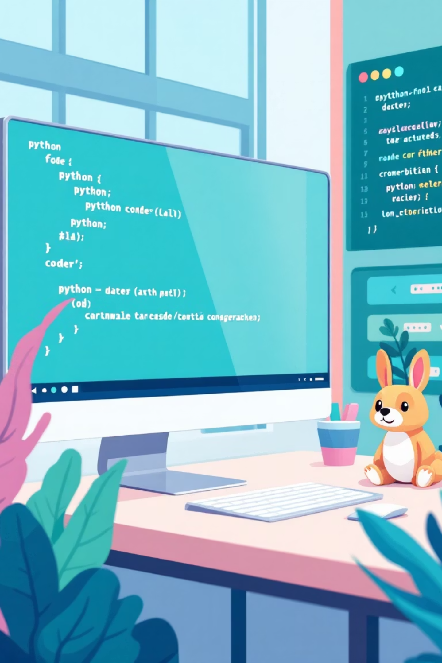
Technology Stack
Python 3
Core programming language powering the entire application with robust standard libraries.
PyGame
Graphics and UI framework enabling smooth rendering, event handling, and game loop management.
LLM API
Optional integration for AI-powered question generation and content adaptation.

Slide 7
Project Structure
Clean Organization
/src
├── main.py
├── screens/
│ ├── start.py
│ ├── quiz.py
│ └── result.py
├── assets/
│ ├── images/
│ └── fonts/
├── questions.json
└── ai_module.py
The codebase follows a modular architecture with clear separation of concerns.
Key Components:
Main entry point and game loop
Individual screen modules
Static assets and resources
Question data storage
Optional AI integration

Slide 8




UI Screen Flow
Start Screen
Welcome interface with game instructions and start button
Quiz Screen
Interactive question display with timer, options, and progress indicator
Result Screen
Score summary with performance feedback and replay option

Slide 9
Technical Challenges Solved
Multi-Screen State Management
Implemented a robust state machine to handle transitions between Start, Quiz, and Result screens while maintaining game data integrity throughout the user journey.
Smooth Transitions & Animations
Developed custom animation controllers using PyGame's frame-based rendering to create fluid visual effects without impacting performance or timer accuracy.
Event Handling & User Input
Created an event queue system that manages multiple user interactions simultaneously while preventing input conflicts during answer selection and navigation.

Slide 10








MINI QUIZ Development Timeline
12–14 Nov
Team discussion
Shreyash coordinate with Group 4 (flowchart+pseudocode)
Received flowchart & pseudocode
15 Nov
Ayush: error review
16 Nov
Samira: follow-ups (G3 & G4)
Samira: follow-ups (design + changes)
Shreyash + Ayush: error analysis
17 Nov
Updated pseudo & flowchart received
Samira → sent to design
18 Nov
Shreyash → backend start
Samira: interface received
Ayush → frontend start
Backend + frontend continue
19 Nov
Samira: design changes checked
20 Nov
Shreyash: backend complete
Ayush: frontend progress
Samira: design collected
Ayush: almost done
21–23 Nov
Shreyash: backend + GUI
Entire project completed
Group 2 — MINI QUIZ Project Completed

Slide 11




Future Enhancements
Global Leaderboard
Enable competitive play with persistent score tracking and rankings
Multiplayer Mode
Real-time head-to-head quiz battles with friends
Adaptive Difficulty
AI-powered question selection based on user performance
"Quizzify delivers a clean, fast, and engaging quiz experience with a scalable architecture ready for future innovation."

